Slide 1
Saint Mary’s College of California
Faculty Fellowships Workshop:
Fulbrights and Other Opportunities
Presented by the Office of Research
Elizabeth Gallagher, DMA, Director, Office of Research
Dami Adeleke, LLM, Assistant Director, Office of Research
Thursday, May 22, 12 pm

Slide 2
Introductions
Presenters and Guest Speakers
Elizabeth Gallagher, Director, Office of Research
Dami Adeleke, Assistant Director, Office of Research
Chi-An W. Emhoff Ph.D
Assoc. Professor, Kinesiology & Interim Director, Health Science
Rosana Barragán
Associate Professor of Dance and Director of MFA in Dance
Technical support provided by MJ Son, Student Assistant, Office of Research
This webinar is being recorded
Notes:
Introductions

Slide 3
Workshop Overview
Introductions and overview
Fulbright awards
  Various options depending on project and timeline
  Case Study I
  Case Study II
Other types of fellowships
How to apply to support your scholarly project
Q & A
Notes:
Introductions

Slide 4
Background
What is a Fulbright?
Established in 1946 by Congress and funded by the U.S government
The Fulbright Program sends U.S. academics and professionals who are U.S. citizens overseas and brings scholars and professionals from abroad to the U.S.
It is sponsored by U.S. Department of State’s Bureau of Educational and Cultural Affairs and administered by the Institute of International Education’s Council for International Exchange of Scholars (CIES)

Slide 5
Background
Why Fulbright?
Fulbright supports your professional development
It allows you to teach, research, carry out professional projects and participate in seminars around the world.
Helps to foster sustainable partnerships and join a vibrant and supportive alum network
Expands your publishing network and gain new teaching perspectives.
Gain professional recognition as a Fulbright Scholar

Slide 6
Fulbright Fellowships
Types of Fulbright awards for SMC faculty
Fulbright U.S. Scholar Awards
Fulbright Specialist Program
Fulbright U.S. Distinguished Scholar Awards

Slide 7
Case Study I
Chi-An W. Emhoff Ph.D
Fulbright U.S. Scholar Alumna

Slide 8
Fulbright U.S Scholar Award
Fulbright Scholar Award
Awards are created in the hosting country by the local Fulbright commission or the American embassy
U.S. citizenship
A Ph.D. or other professional/terminal degree in your field
For professionals and artists outside academia, recognized professional standing and substantial accomplishments
Teaching experience as required by award
Preference for Fulbright Scholar opportunities will be given to candidates who have not previously received a Fulbright Scholar grant

Slide 9
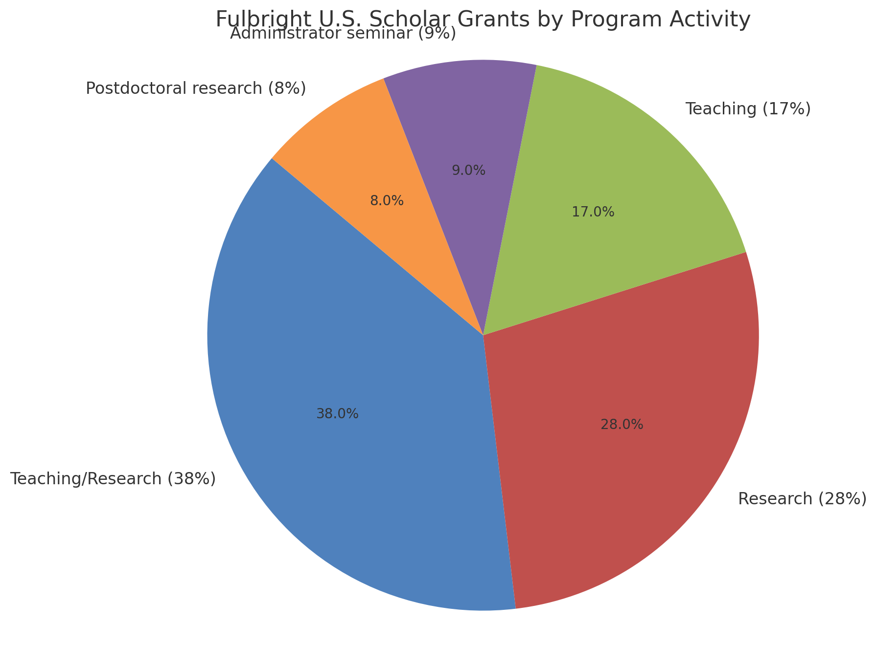
Fulbright Scholar Program
Distribution of Opportunities 2022-2023
Fulbright awards allow academics and professionals to participate in a wide variety of activities:
Teaching/Research (38%)
Research (28%)
Teaching (17%)
Administrator seminar (9%)
Postdoctoral research (8%)

Slide 10
Case Study II
Rosana Barragán, Fulbright Specialist

Slide 11
Fulbright Specialist Award
Fulbright Specialist Award
Two- to six-week consulting and/or teaching opportunities per project
Institutions overseas create projects and request specialists from the roster
Six application deadlines per year
Applicants are peer reviewed and placed on Fulbright Specialist roster for five years
Program does not support research
Twenty-four eligible disciplines, including STEM education fields (at discretion of host university)

Slide 12
Fulbright Distinguished Scholar
Fulbright Distinguished Scholar Award
The Fulbright Distinguished Scholar Award is a prestigious component of the Fulbright U.S. Scholar Program.
It is designed for accomplished scholars and professionals with a significant publication and teaching record, offering them the opportunity to engage in advanced research and/or teaching overseas.
Target audience include senior scholars, faculty members at the rank of full professor, or professionals with comparable credentials.

Slide 13
Other Types of Fellowships
Federal
  ​NEH Fellowship
Organizations
  American Council of Learned Societies
  American Association of University Women
  Your professional association: check “funding” pages
Funding Searches
  SPIN database – always check main website after you find a lead
  Listings on Office of Research Fellowships page
If you think you have found an opportunity, check the eligibility first, as criteria vary widely

Slide 14
How to Apply Overview
Typical Fellowship Application Components
Application form
Project statement + reference list (for research fellowships)
Curriculum vitae or resume
Course outlines or syllabi (for Fulbright teaching awards)
Recommendation letters
Language proficiency report (if required)
Letter of invitation (if required) – Important for Fulbright!
Portfolio for certain types of projects (arts, writing, databases)

Slide 15
How to Apply Overview
Best Practices
Start as early as you can
﻿﻿Reflect on the state of your career, your field, and current events in countries abroad, then define your project
Who is publishing in your field? Connect!
Review lists of prior recipients Connect!
Identify potential host institution and contact them Connect!
Follow guidelines exactly – content, format, character limitations, timelines
Collaborate with the Office of Research

Slide 16
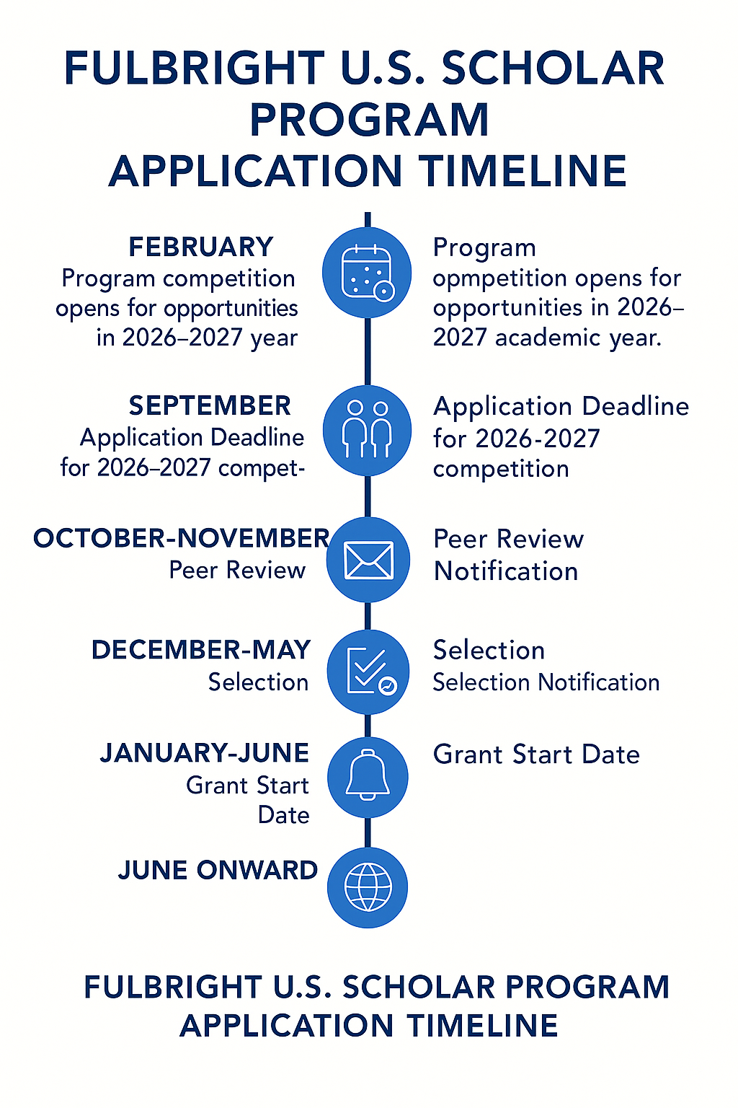

Slide 17
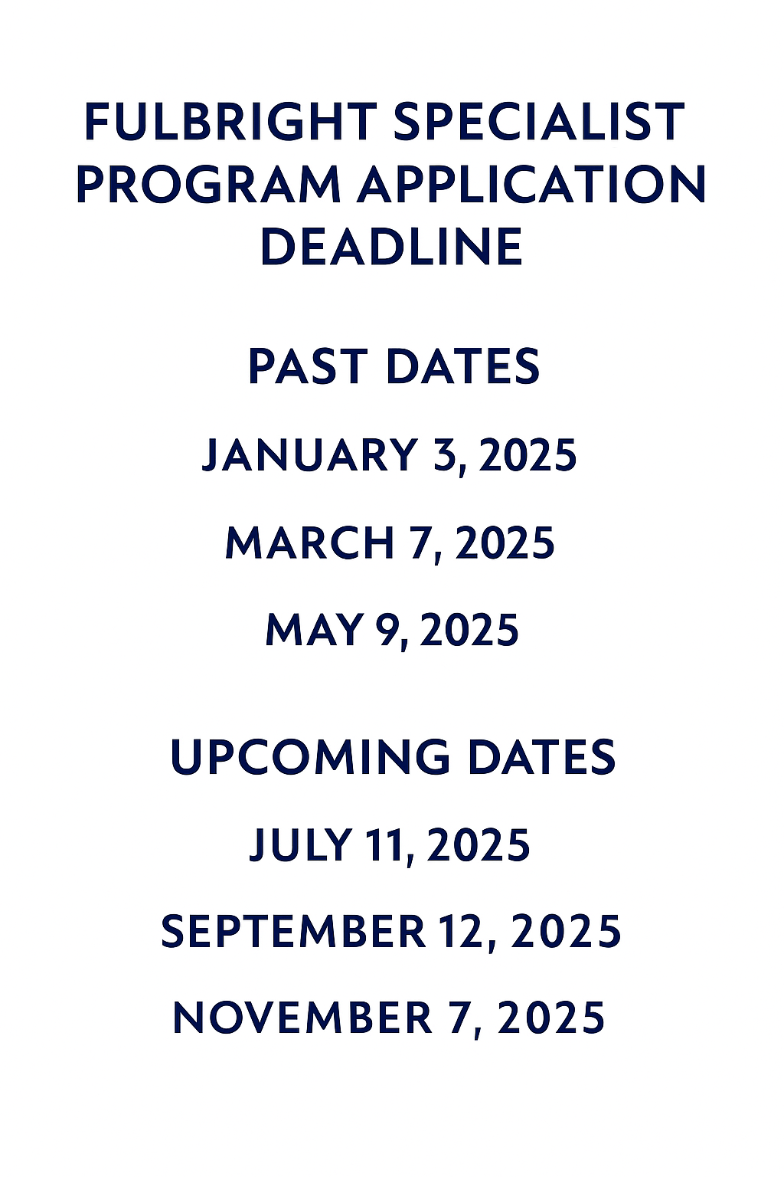

Slide 18
Technical Guidance
Select Award Options for Your Fulbright Project
Links:
  Scholar – Fulbright Scholar Awards
  Specialist– Fulbright Specialist Awards
  Distinguished – Fulbright Distinguished Scholar Awards
Choose the most specific award that meets your needs
  Explore by “country,” “discipline,” or “named institution”
  ﻿﻿Use a wider range of key words to make sure you turn up hidden gems
  Search by activity – teaching, research, or both
Read award descriptions and stipend information carefully
Contact program officer(s) for more information

Slide 19
Fulbright Scholarship
Requirement | Fulbright U.S. Scholar | Fulbright Specialist | Fulbright Distinguished Scholar
Citizenship | U.S. citizen | U.S. citizen | U.S. citizen
Eligibility | Faculty, researchers, professionals with terminal degree or equivalent | Mid-career to senior-level professionals (min. 5 years experience) | Senior-level academics, full professors, or professionals with extensive accomplishments
Academic Credentials | Ph.D. or terminal degree (or equivalent experience) | No Ph.D. required, but significant expertise required | Must have a strong publication, teaching, and/or research record
Project Scope | Teaching, research, or both | Short-term consulting, teaching, or training (no research) | Advanced teaching or research project
Length of Award | 2–12 months (some with Flex option) | 2–6 weeks | Typically 3–12 months
Application Frequency | Annual call for proposals | Rolling roster application (matched to host institutions later) | Annual call within the U.S. Scholar competition
Host Invitation | Usually required or encouraged | Not needed for initial application (host initiates project later) | Required or strongly preferred
Languages | English usually sufficient; local language may be required for research | Varies depending on host institution | As needed, based on location/project
Compensation & Support | Varies by country; typically includes stipend, travel, living allowance | Travel + per diem paid by host institution or Fulbright | Higher-level compensation packages and additional recognition
Deadline | Once a year in September | Every other month / six times per year | Once a year in September

Slide 20
Contact Information
Elizabeth Gallagher, DMA, Director, Office of Research
Filippi Administration Building 225 | egallagher@stmarys-ca.edu
Dami Adeleke, LLM, Assistant Director, Office of Research
Filippi Administration Building 221 | oma7@stmarys-ca.edu
Chi-An W. Emhoff, PhD, Associate Professor of Kinesiology
cwe1@stmarys-ca.edu
Rosana Barragán, MFA, Associate Professor of Performing Arts
rb7@stmarys-ca.edu
Office of Research | www.stmarys-ca.edu/offices-services/research

Slide 21
Questions
Q and A

